Slide 1

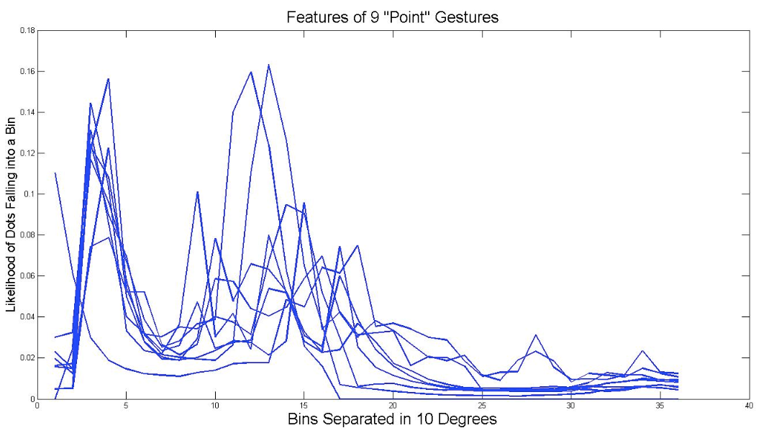
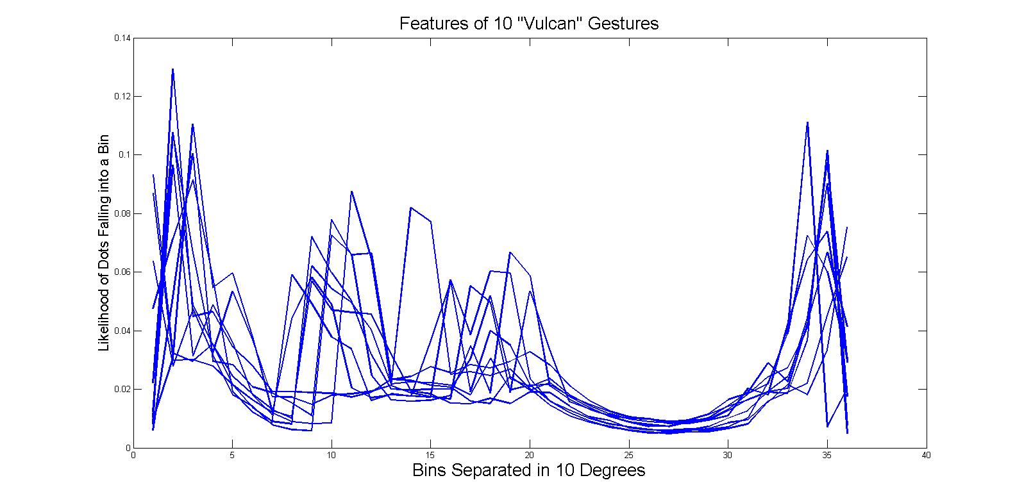
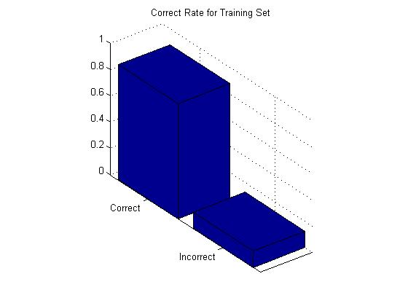
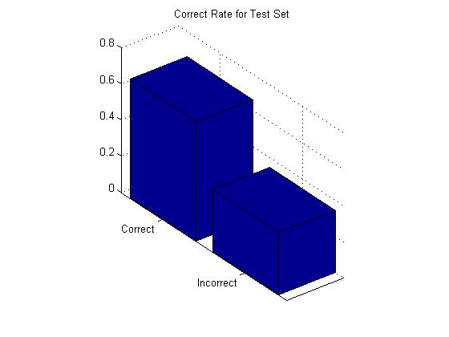
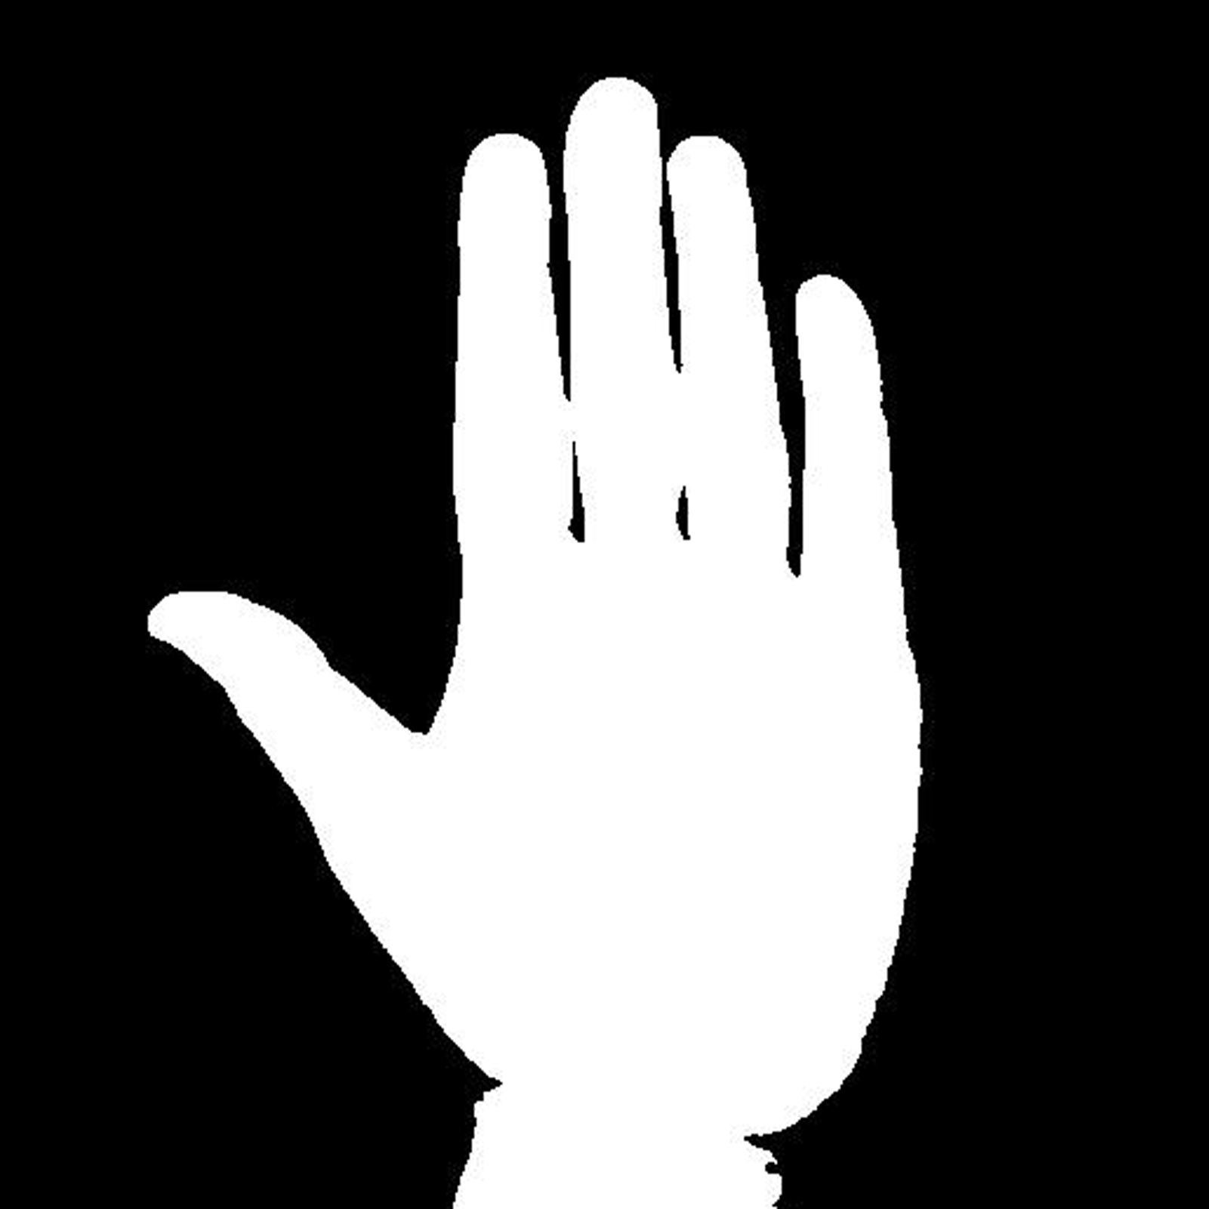



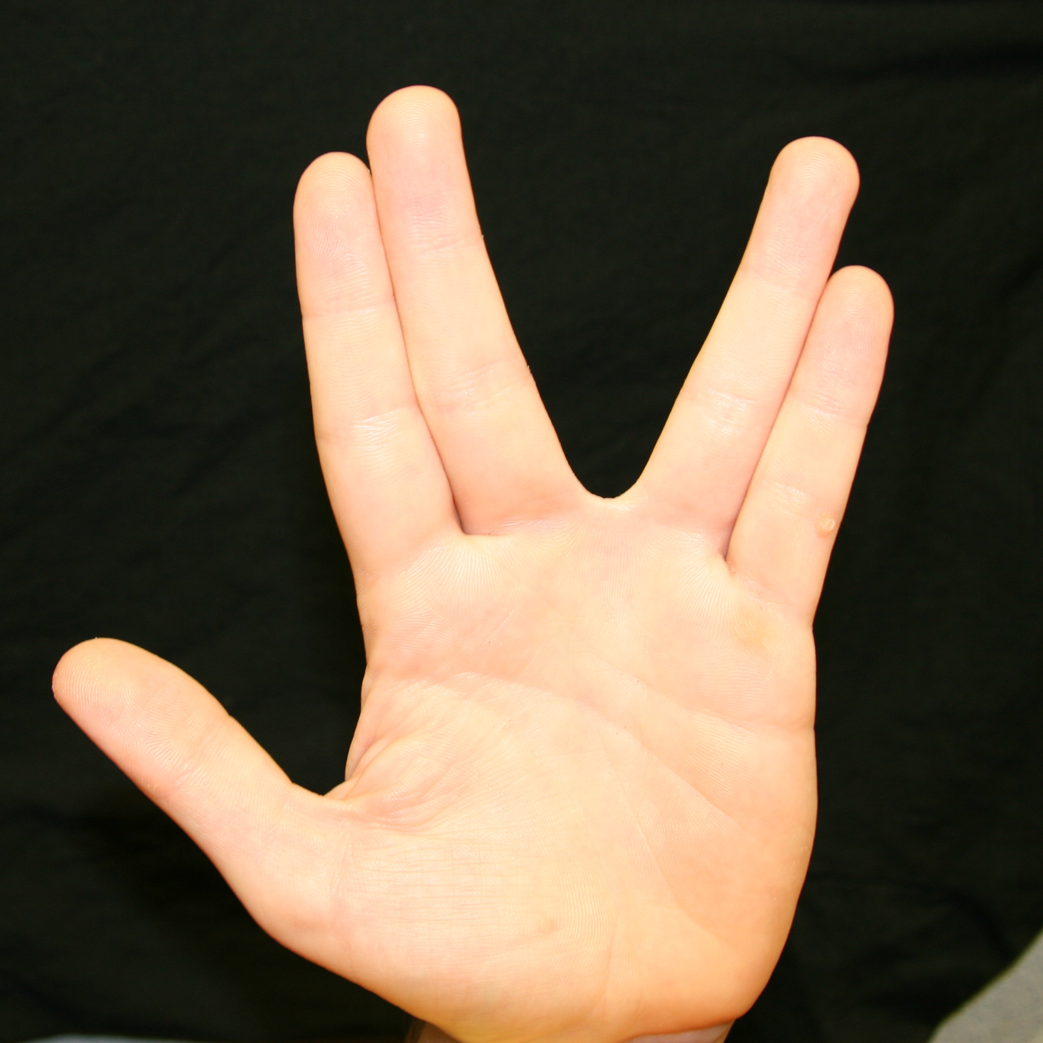
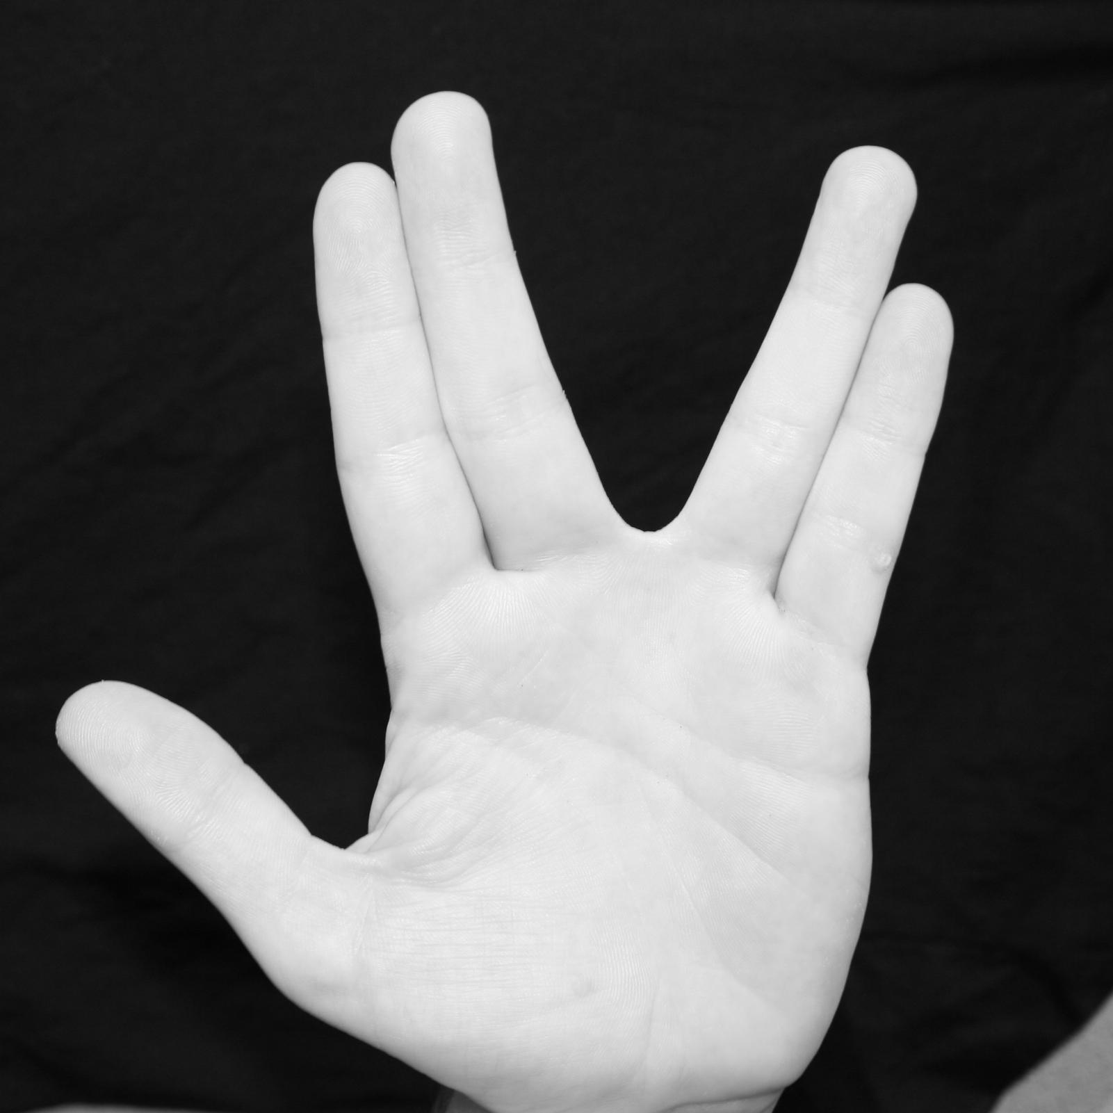
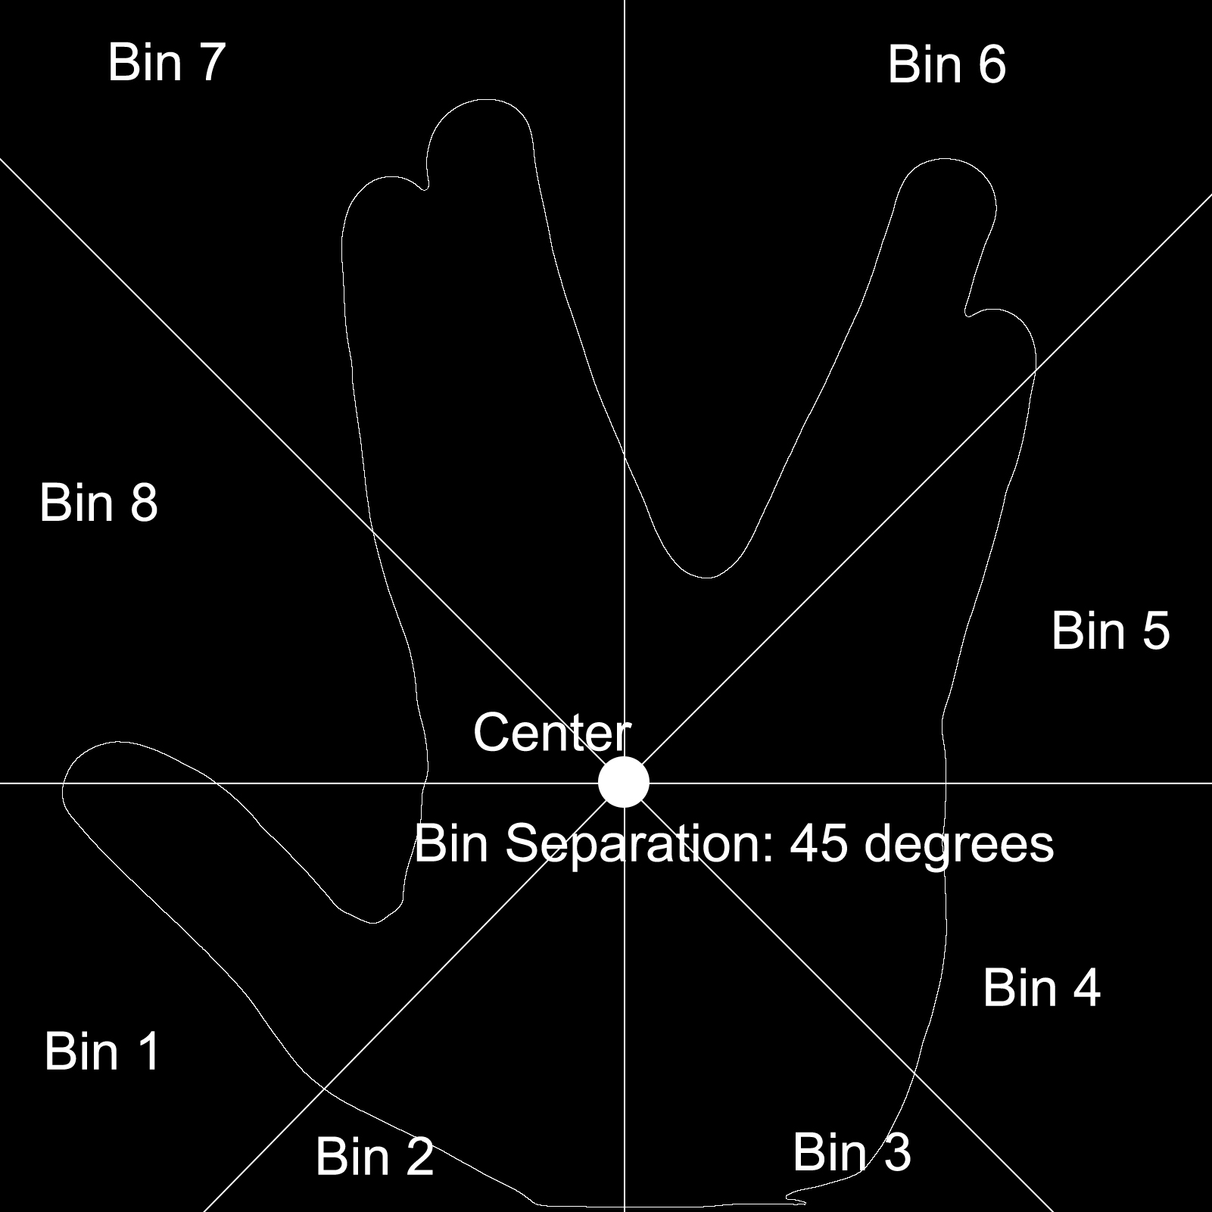
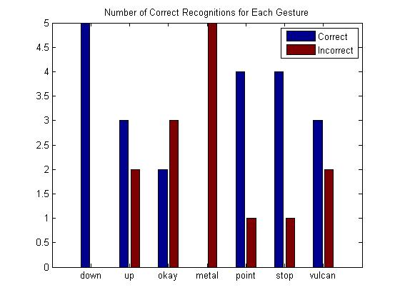
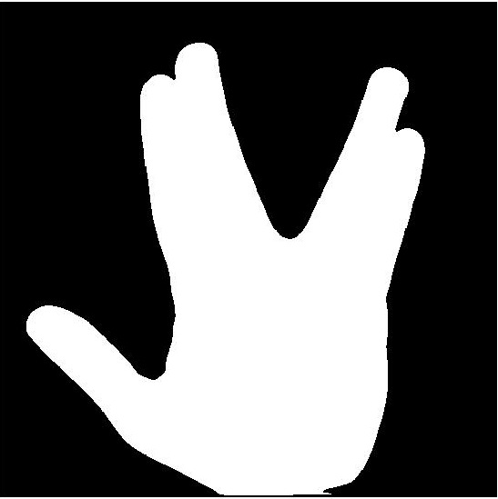
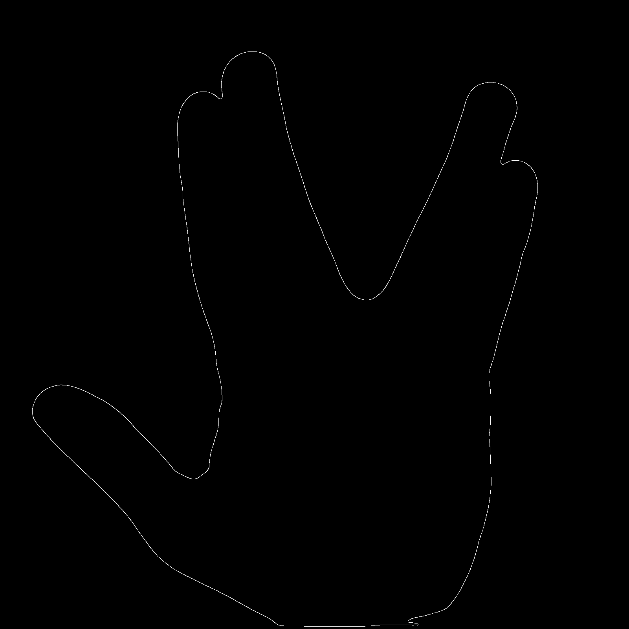
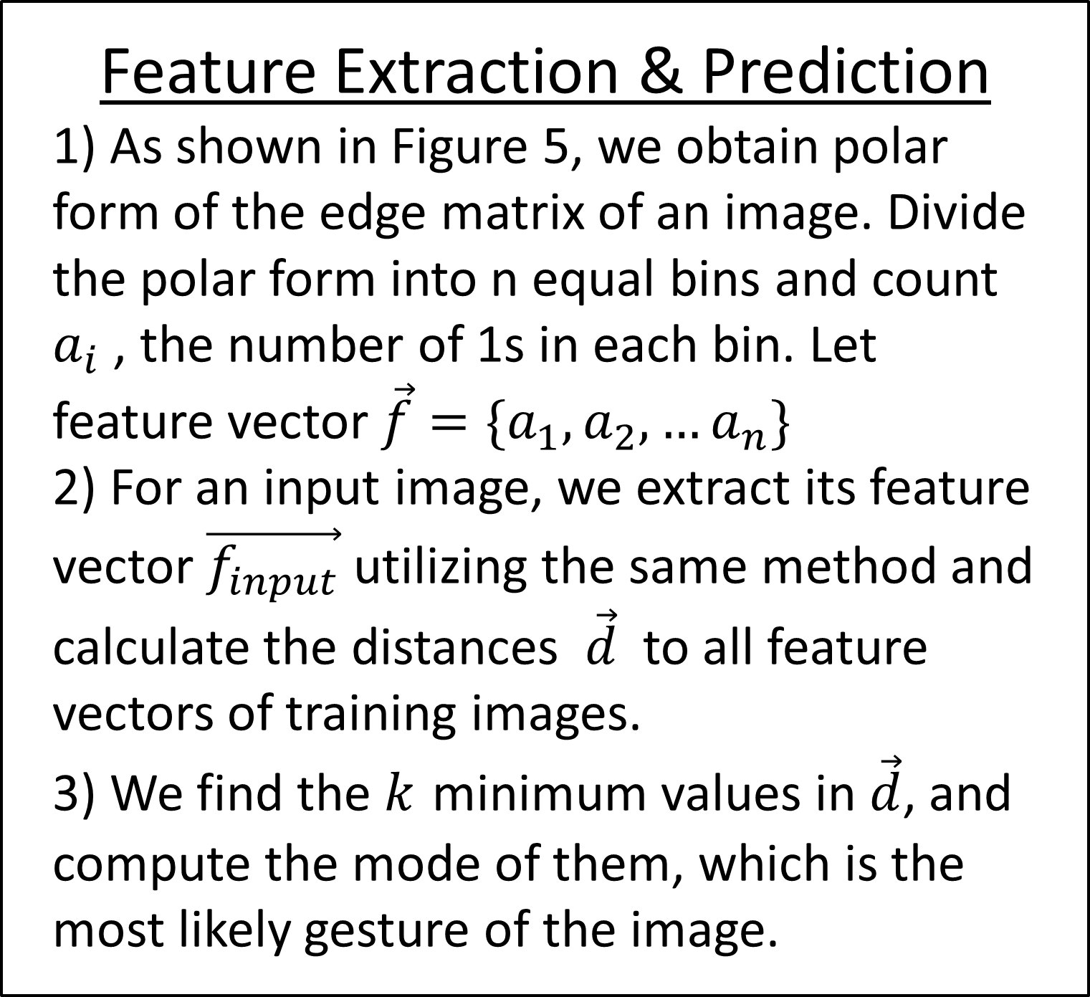
2D Still Image Hand Gesture Recognition Zihe Huang, Chenxin Fu, Minyang Ma, Aoliang Zhi
Flow Chart
Sample Gestures
(Training Data)
Introduction & Background
Results
Hand gesture is useful for processing information from humans which is not conveyed through speech or type. In this project, we developed a 2D hand gesture recognition method which is able to identify simple static hand gestures like “stop”, “point”, ”okay” and “up” etc.
Hand gesture recognition can be used for the purpose of security, remote control and assistance for certain group of disabled people(e.g. a tool of sign language translation). What is more, it increases the intuitive interactions between human and computer.
Edge
Detector
Feature
Extraction
Processing Images
Making Prediction
Before Feature Extraction
1) Take a group of training images for each gesture, one of which is the “Vulcan” gesture (Figure 1).
2) Convert image to grayscale. (Figure 2)
3) Filter out noise and convert the image to a binary matrix and label the largest component in our image matrix (Figure 3)
4) Obtain edge of the gesture.(Fig. 4)
5) Repeat this procedure for all 7 gestures.
Feature Extraction & Prediction
1) As shown in Figure 5, we obtain polar form of the edge matrix of an image. Divide the polar form into n equal bins and count $a_{i}$, the number of 1s in each bin. Let feature vector $\vec{f}=\{a_{1},a_{2},…a_{n}\}$
2) For an input image, we extract its feature vector $\vec{f_{input}}$ utilizing the same method and calculate the distances $\vec{d}$ to all feature vectors of training images.
3) We find the $k$ minimum values in $\vec{d}$, and compute the mode of them, which is the most likely gesture of the image.
Feature
Analysis
Compare to
Training data
Derive
Conclusion
Future Work
Increase the number of gestures in our training model.
Expand the work content into motion gesture detection
Exploit the point distance factor and add to the feature of the gesture.
Summary of Methods
Figure 1
Figure 2
We use edge detector to obtain the edge of the gesture and collect features of the image to construct our training data. Then we compare the test image to our training data and select the closest gesture among our 7 gestures.
Acknowledgement
Our group thanks Prof. Baraniuk, Dr. Kaushik Mitra and our TA Rajen Patel for their assistance
Figure 3
Figure 4
Figure 5

